Slide 1


STANDARD CO
Claude 101 🎉
An introduction to Claude, how it works, and what it means for your data
Standard Co 45-minute walkthrough

Slide 2
What we'll cover today
💬
What Claude is
🧠
How it works
Who built it, what it does, and how you actually use it. We'll demystify the basics in plain English.
The 60-second version of large language models — including what Claude is good at, where it trips up, and how to prompt it well.
📚
What RAG is
🚀
Where this can go
Retrieval-Augmented Generation — the technique that lets Claude answer questions using YOUR documents and data.
Agents, custom connectors, and what becomes possible once Claude is wired into how your organization actually runs.
45 minutes. No prior AI knowledge required. Bring your questions.

Slide 3
What is Claude?
Claude is an AI assistant built by Anthropic. You talk to it in plain English — it reasons, writes, analyzes, summarizes, and can even use tools on your behalf.
🏢
🎚️
🌐
Built by Anthropic
A family of models
Many ways to use it
AI safety company founded in 2021, headquartered in San Francisco. Mission: build AI that's helpful, harmless, and honest.
Different sizes for different jobs — Opus, Sonnet, Haiku. You pick the balance of speed, cost, and depth that fits the task.
Chat in a browser, work in a desktop app, embed it via API, or integrate it with the software your team already uses.
Think of Claude as a brilliant, fast collaborator who reads, writes, and reasons — and can scale across thousands of tasks at once.

Slide 4
The LLM landscape
Claude is one of several major AI models. Here's how they compare — and why Claude leads on enterprise.
🏢 Anthropic — Claude
💡 OpenAI — ChatGPT
Best-in-class at long-context reasoning, careful writing, and following nuanced instructions. Built by ex-OpenAI safety researchers.
The household name. Broad recognition, fast feature releases. Mixed track record on enterprise data handling; can drift on long tasks.
🔍 Google — Gemini
🛠️ Open source — Llama, Mistral
Tightly integrated with Google Workspace. Strong on multimodal tasks (images, video). Generally less polished on nuanced writing and reasoning than Claude.
Free to self-host with full control. Trade-off: meaningfully lower capability and you maintain the infrastructure. Useful for narrow, specific tasks.
Why Claude for enterprise: strongest on careful reasoning, transparent on safety, best on long documents, and built by a team where data privacy is a founding principle.

Slide 5
What Claude does well
Claude punches above its weight on these four. Each has direct relevance to how your team works with information.
✍️ Writing & editing
🔍 Analysis & synthesis
Drafts, edits, summaries, translations. Give it a few examples and it'll adopt your tone.
Reads long documents, pulls out key points, finds patterns, compares sources — at speeds humans can't match.
🧭 Research & thinking
💻 Coding & automation
Helps you weigh options, structure arguments, and pressure-test ideas. A genuinely useful thinking partner.
Writes, reviews, debugs, and explains code. Strong even for non-engineers who want to automate work.
These are all reading, writing, and reasoning tasks — exactly what Claude was trained to do well.

Slide 6
Three ways to use Claude
Claude shows up in three different surfaces. For your team's day-to-day work, the first two are what matter most — Code is a specialist tool for developers.
💬
🤝
💻
Chat (Claude.ai)
Cowork (Desktop)
Code (Terminal)
The simplest entry point. Open a browser, ask a question, get an answer. Perfect for one-off writing, research, analysis. This is where most people start.
Claude lives on your computer, can read your files, connect to your tools, and work alongside you on real tasks. The team-scale version of Chat.
A specialized command-line tool for engineers — Claude writing and running code in their terminal. Powerful, but not where most of your team will spend time.
For many, the focus is Chat and Cowork — that's where the leverage lives for non-engineering teams.

Slide 7
How to talk to Claude
What you get out depends a lot on what you put in. Three habits change everything about the quality of Claude's output.
🎯
⚡
🔁
Give it context
Show, don't just tell
Iterate, don't stop
Who's the audience? What's the goal? What format do you want back? The more specific the setup, the better the answer.
Examples are gold. "Here are two past reports — write the next one in this style." Demonstrate the output you want.
Treat it like a conversation, not a vending machine. Ask, refine, redirect. Great results usually arrive 2-3 turns in.
Better prompts beat better models. The same Claude in different hands produces wildly different results.

Slide 8
What this looks like in practice
A few concrete examples of how teams use Claude every day. None of these require AI expertise — just a clear ask and a few examples.
📨
📑
🧹
Board update
Report summary
Data cleanup
"Here are last quarter's metrics and three new initiatives. Draft a board memo in our usual style." Two paragraphs of inputs become a polished draft in 90 seconds.
"Read this PDF and pull the three findings most relevant to our remediation programs." Hours of reading collapsed into a 5-minute review.
"This data is in 6 different formats. Clean it up, dedupe, and give me a one-page summary of the patterns." Hours of data wrangling, gone.
The pattern: "Here's some material. Here's what I want done with it. Go." — that single move covers 80% of useful Claude usage.

Slide 9
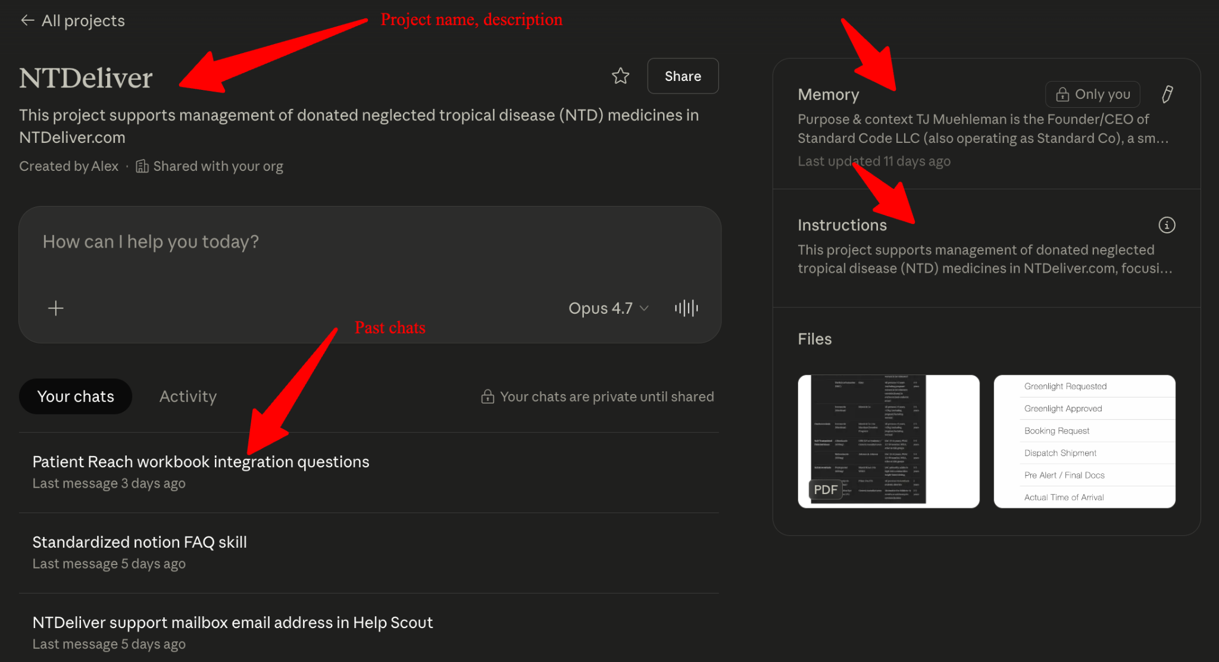
Projects + Memory

Slide 10
The catch: Claude doesn't know YOUR world
Out of the box, Claude is a brilliant generalist with zero context about your organization. It hasn't read your reports, your databases, your internal docs, your field data.
📚 It hasn't read your knowledge base, SOPs, or internal documents
📊 It can't see your spreadsheets, dashboards, or databases
📧 It doesn't know what was said in last week's meetings or emails
👥 It has no idea who's on your team or what they're working on
💡 Good news: the next slides are about how we fix that — without retraining the model

Slide 11
Enter RAG (Retreival Augmented Generation)
RAG is the technique that lets Claude answer questions using YOUR documents and data — without retraining the model.
📄 PDFs & Docs
📊 Spreadsheets
Claude
+ Your Data
RAG
🗂️ Reports
💾 Databases
"Open-book exam"
📝 Meeting notes
📚 Knowledge base
Think of it like an open-book exam. Claude looks up the right pages from your data — then writes the answer using what it found.

Slide 12
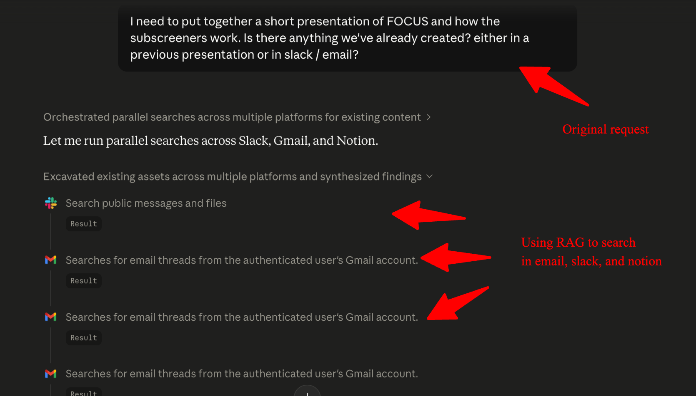
RAG in the real world

Slide 13
Where Standard Co comes in
🧭 Strategy
🛠️ Build
🌱 Adopt
Map your data and workflows. Find the highest-leverage spots to deploy Claude.
Custom connectors, RAG pipelines, agents — wired into your existing tools.
Training, change management, and ongoing support so it actually sticks.
📚 Knowledge RAG
📊 Data agents
🔌 Connectors
🧭 Workflow design
Ask your own reports and SOPs
Auto-pulled insights from your data
Plug Claude into your actual tools
From idea to deployed automation
Let's talk about what's possible – tj@standardco.de

